Slide 2
objectives
Use digital color histograms to segment regions of interest in an image.
Compare the strengths and limitations of three segmentation techniques.
Explore how these segmentation techniques have practical applications.
result 1
result 2
Physics-301/Activity 1 - Color Segmentation.ipynb at main · reneprincipejr/Physics-301 (github.com)
https://drive.google.com/file/d/10yAmcNsyWs8dfkm6fHbPrnsFiF5YHBX9/view?usp=sharing

Slide 3
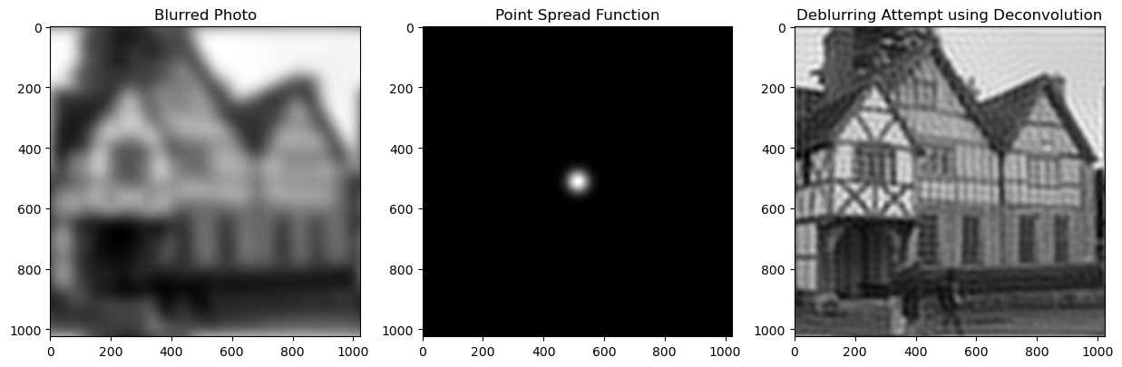
Background

Slide 4
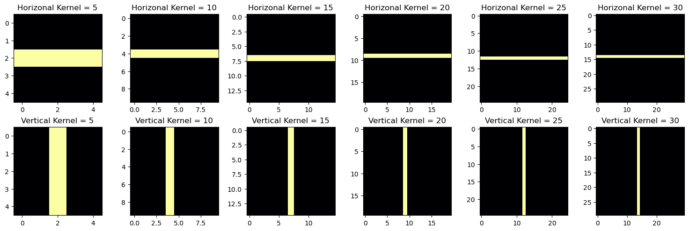
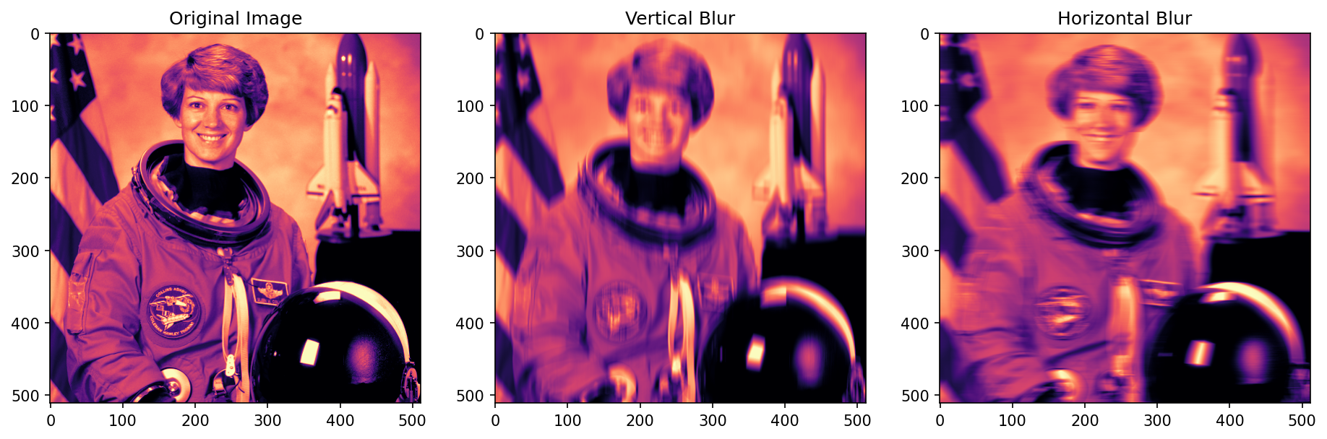

Slide 5
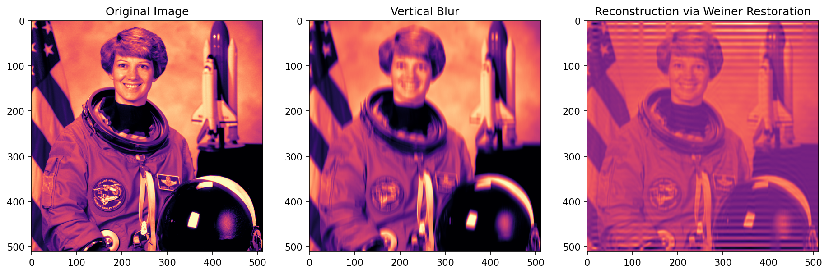

Slide 6
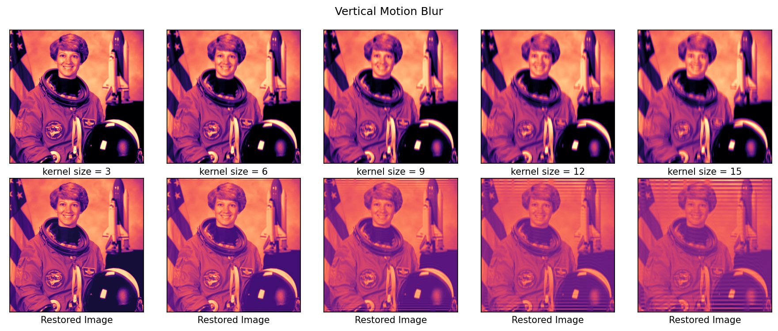

Slide 7
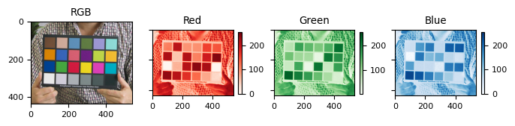
Background
Human eyes have cones and rods which allows depiction of trichromatic color and brightness, respectively. The same mechanism governs how digital cameras capture color and how devices display them accordingly. For example, a colorful image shown below is a combination of responses from the three primary channels, namely Red, Green, and Blue [1][2].
Looking closely, red colors from the RGB image have higher intensities on the red channel but have low response on other channels. The same is true for the green and blue colors, respectively. Secondary colors like yellow, cyan, and magenta are a mixture of high response from two channels constituting their color.

Slide 8
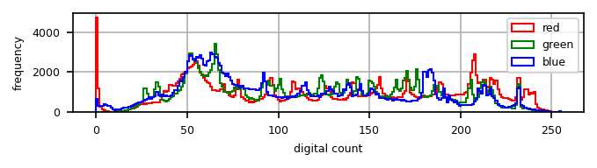
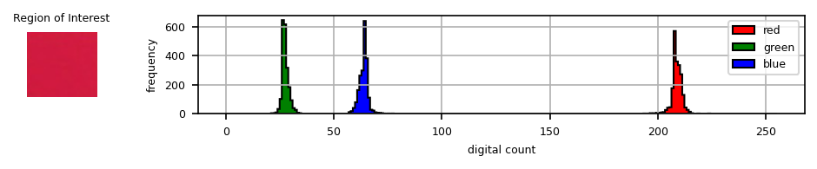
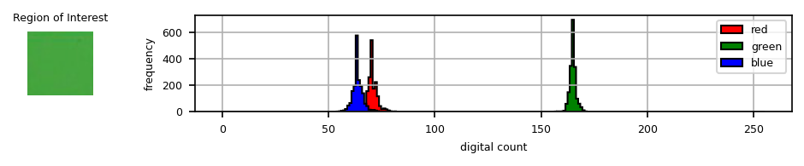
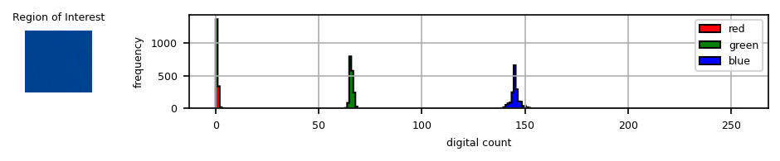
RGB Histograms
Looking at the histogram, we can see that the RGB image has a continuous distribution of color intensity. Now looking at some specific Regions of Interest (ROI), the color distributions are narrower and much more distinct in accordance with the dominant primary color in the ROI.

Slide 9
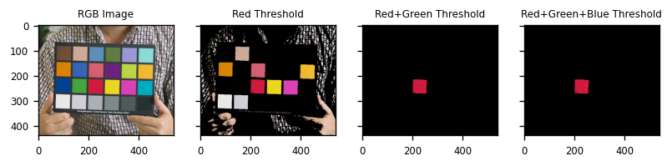
Thresholding
In this activity, we first exploit ROI histograms to segment images in a technique called thresholding. Essentially, we only take the pixel values of the RGB image which falls within the non-zero bin range of the ROI. The rest will be assigned to zero.
As shown below, choosing the red patch means that the histogram must only allow pixels with R: 200-250, G: 10-40, and B: 50-80 for the RGB image using logical AND operator.

Slide 10
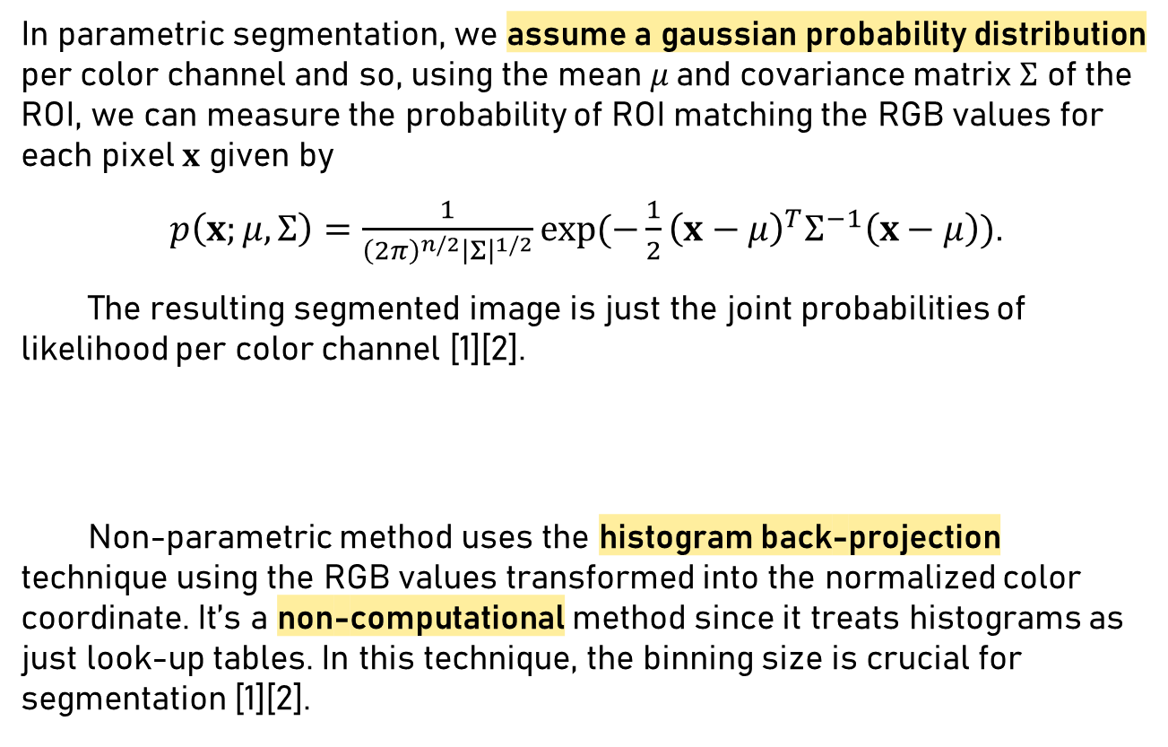
Parametric
In parametric segmentation, we assume a gaussian probability distribution per color channel and so, using the mean$μ$and covariance matrix $Σ$ of the ROI, we can measure the probability of ROI matching the RGB values for each pixel $x$ given by
$p\left(x;μ, Σ\right)=\frac{1}{{\left(2π\right)}^{n/2}{\left|Σ\right|}^{1/2}}\exp{(−\frac{1}{2}{\left(x−μ\right)}^{T}Σ^{−1}\left(x−μ\right))}$.
The resulting segmented image is just the joint probabilities of likelihood per color channel [1][2].
Non-parametric method uses the histogram back-projection technique using the RGB values transformed into the normalized color coordinate. It’s a non-computational method since it treats histograms as just look-up tables. In this technique, the binning size is crucial for segmentation [1][2].
Non-parametric

Slide 11
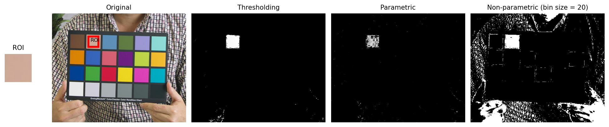
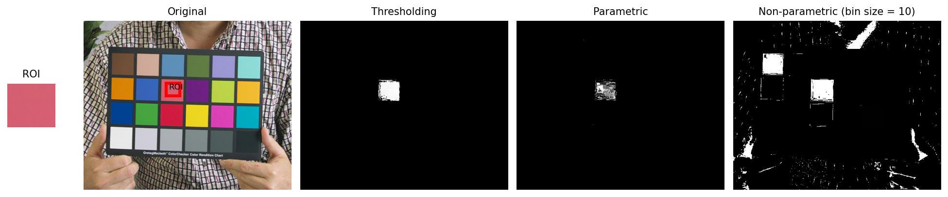
Results
Taking the light-brown and pink patch as ROIs, both first two algorithms had a very specific spatial segmentation. Intensity difference is just due to the parametric being probabilistic while thresholding retained its original intensity values. The non-parametric method was able to capture the even the brownish pixels in the skin and the shirt color, as well as the pink patterns. Unfortunately, the non-parametric method using the pink ROI has segmented unnecessary regions such us the brown patch and some portions of the skin.

Slide 12
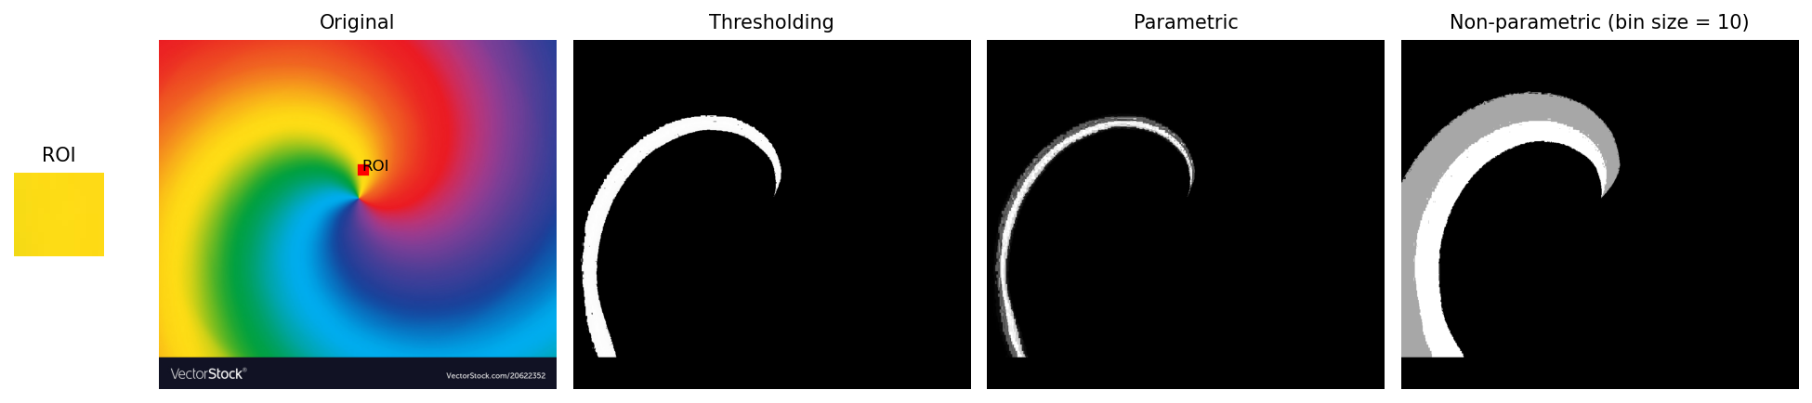
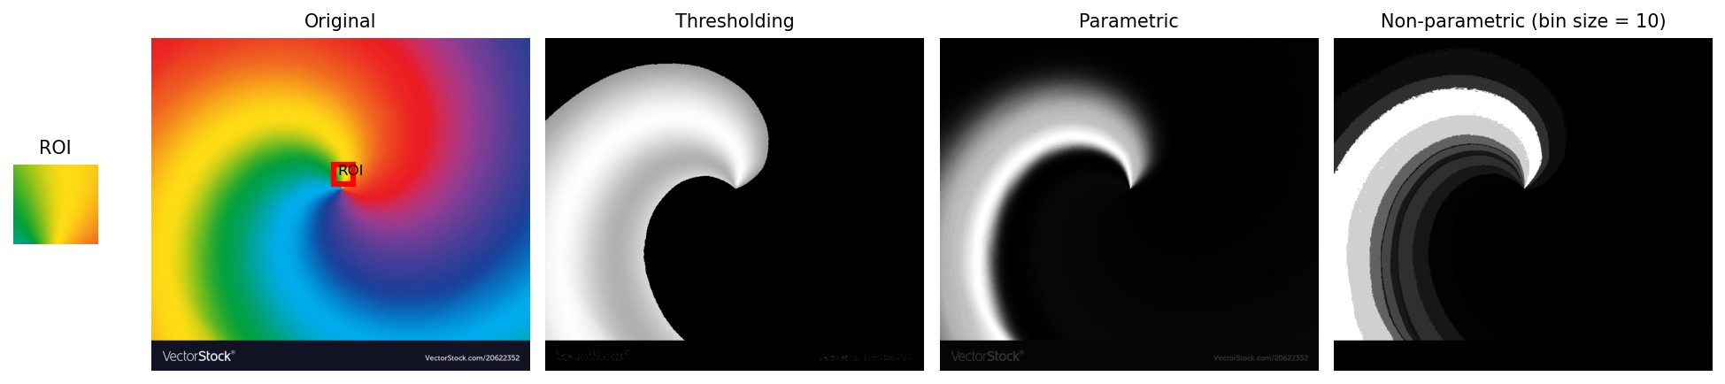
Continuous Image/ROI
I was curious as to know how these algorithms would segment an image with no color discontinuities. Shown below shows the expected segmentation trends across all three methods for the yellow ROI. Interestingly, choosing a continuous green-yellow-orange ROI revealed that thresholding is better in segmenting spatially because of the AND operator embedded. The parametric method had a gradient segmentation due to its gaussian nature while the non-parametric shows discrete segmentation levels due to its discrete binning nature.
https://cdn3.vectorstock.com/i/1000x1000/23/52/abstract-twist-color-radial-gradient-rainbow-vector-20622352.jpg

Slide 13
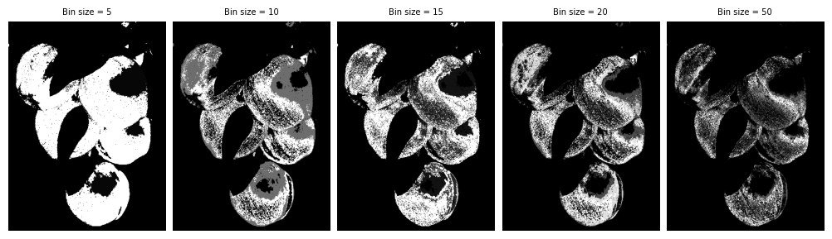
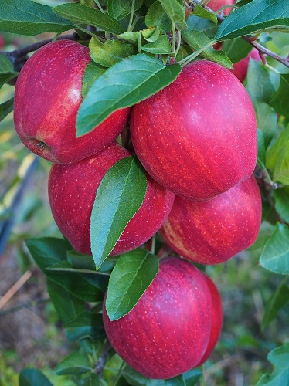
Bin-size effects
The difference of the three algorithms have become more apparent when we applied the techniques on a continuous image and using a continuous ROI. In addition, the binning size is critical to how the non-parametric segmentation works. Larger bin size means smaller bins for the look-up table and thus, the segmentation becomes very specific as shown below.
On the next portions, we look on how these segmentation algorithms fare in practical applications such as art imaging and video biomechanics.
http://www.michiganapples.com/Portals/0/New%20Fall.jpg

Slide 14
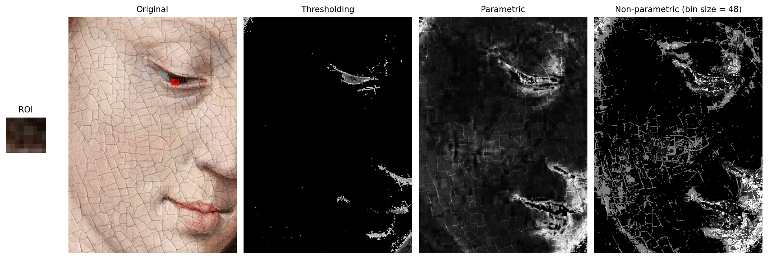
Craquelures
Craquelures are the breakage patterns present in very old paintings commonly due to paint degradation [3]. I applied the algorithms on the sample painting below. Here I chose the eye portion as the ROI as it had similar color to the painting cracks. Thresholding was able to only segment dominant facial lines and shadows, implying that segmentation is better spatially only if the ROI color information is rich. Meanwhile, the other methods captured these “cracks” but parametric segmentation was able to accentuate the finest lines whereas these details could get lost due to the binning limitation of the non-parametric method.
[3] https://www.hki.fitzmuseum.cam.ac.uk/projects/cracks

Slide 15
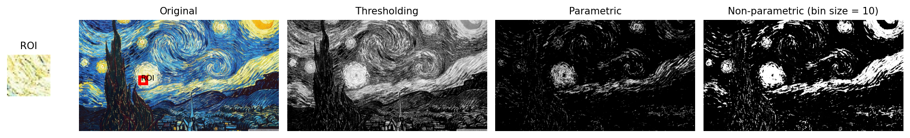
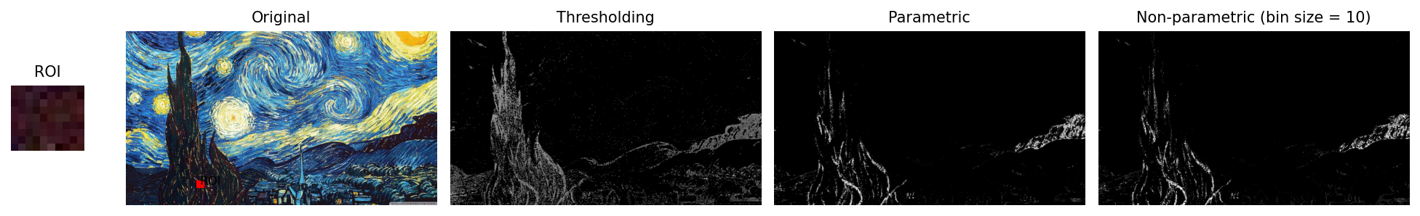
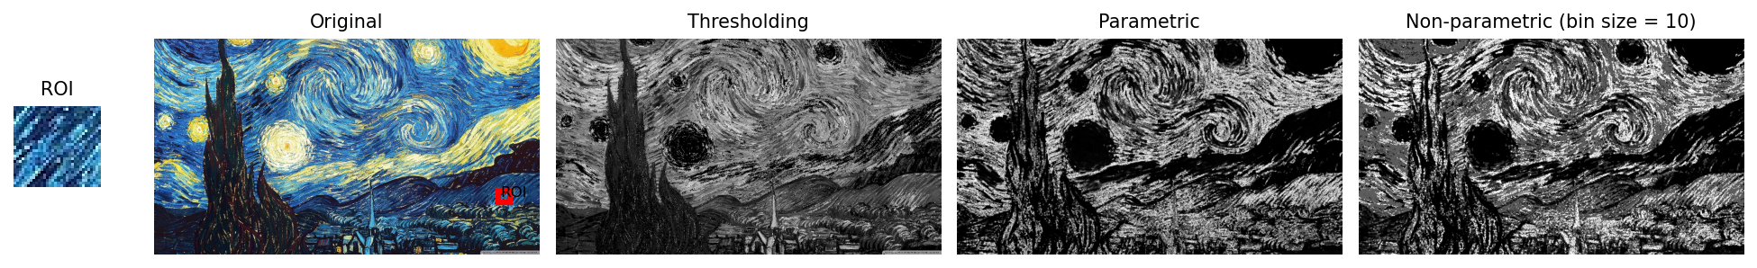
Van Gogh’s Starry Night
Starry Night is a world-renowned painting with distinct stroke styles [4]. By applying segmentation techniques, the image texture is highlighted. Shown below are the patterns extracted using the yellow circular strokes, dark-brown vertical wave strokes, and blue diagonal strokes. Since the ROIs are color rich strokes, we can see how thresholding was able to emphasize the rich pattern. Color segmentation allows us to view art in a different lens and characterize them using quantifiable features such as texture.
[4] https://ustynazimnyfruzynska.blogspot.com/2019/03/gambar-hd-lukisan.html

Slide 16
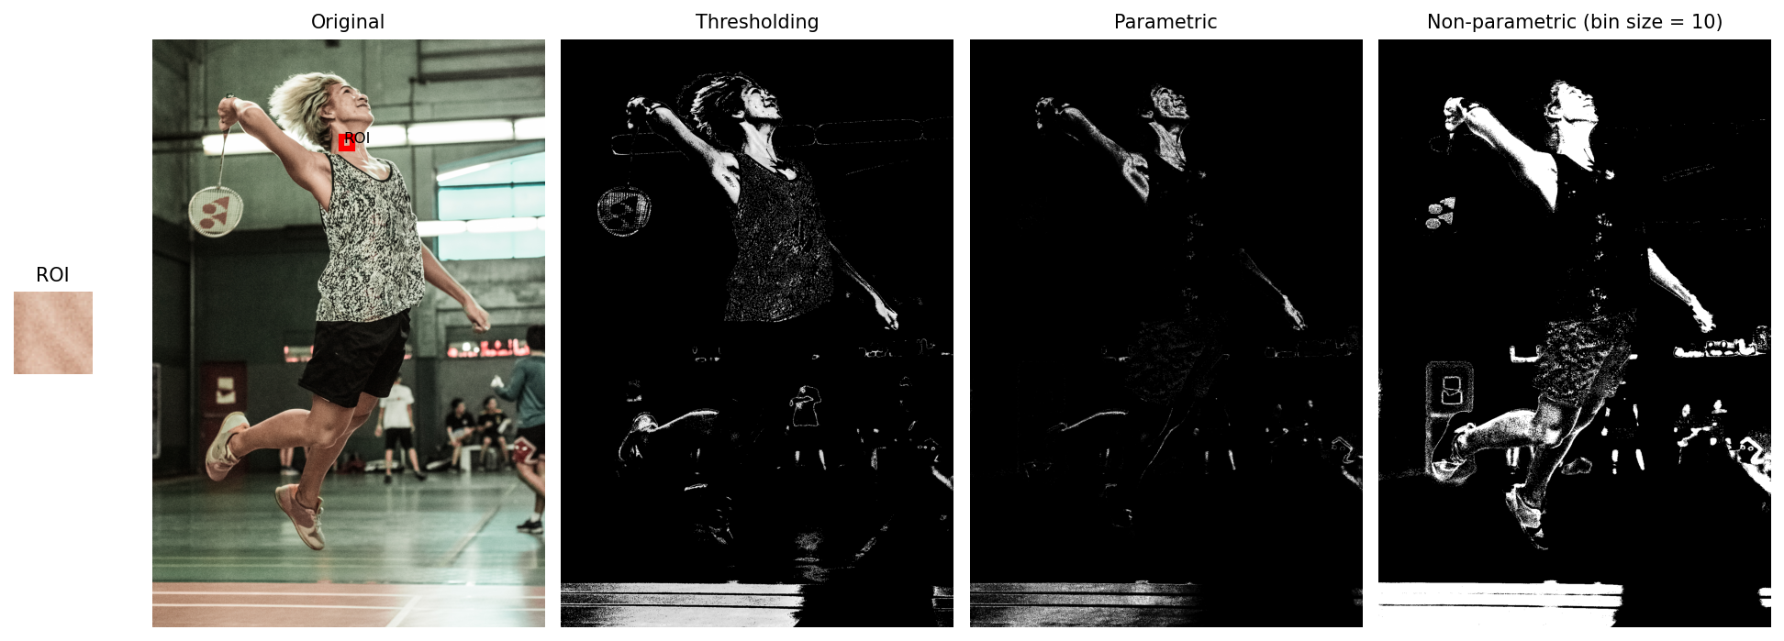
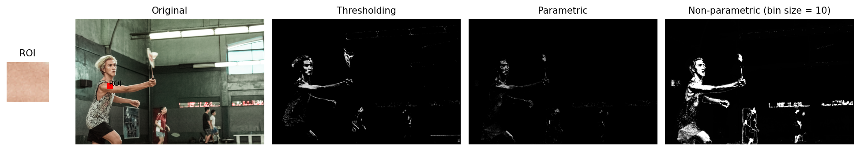
In-motion
In video-biomechanics, tracking movements often starts with segmenting the target region. Using the motion shot captured by Kenneth Domingo, I chose my skin as an ROI. All algorithms segmented the image decently but here we highlight how robust the non-parametric segmentation is given an un-even illumination in the scene.

Slide 17
reflection
My personal research background in image processing helped me a lot in doing this activity with ease. Some of the results presented in this report were recreations of what I did in my Applied Physics 186 – Color Segmentation report. I believe I was able to deliver a sufficient output and explained the nuances in the results using segmentation techniques. By showcasing practical applications in art and biomechanics, the strengths and limitations of the technique were generalized. I thoroughly enjoyed accomplishing this activity.
With that said, I’d give myself a score of 100/100.
[1] M. Soriano, Applied Physics 186 - Image Segmentation, (2019).
[2] M. Soriano, Physics 301 - Color Segmentation, (2022).
[3] https://www.hki.fitzmuseum.cam.ac.uk/projects/cracks
[4] https://ustynazimnyfruzynska.blogspot.com/2019/03/gambar-hd-lukisan.html
M. Bartolome, Activity #7 – Image Segmentation, (2015). https://barteezy.wordpress.com/2015/10/05/activity-7-image-segmentationo/
https://rlprincipe.wixsite.com/reneprincipejr/post/image-segmentation

